Slide 1

Discovering a Global Data Model from Event Logs
Kim-Pascal Borchart
BPI @ HPI
Summer 2021

Slide 2
Agenda
Write your first topic here
Write your second topic here
Highlight your topics by using bold font (change manually)
Write your fourth topic here
If you need further details
Choose the second text layer

Slide 3
Baseline - Model Discovery on Single Event Log
Start
Attr_1
Bano, Dorina & Weske, Mathias. (2020). Discovering Data Models from Event Logs
Case | Activity | Time | Attr_1 | Attr_2 | Attr_3
1 | Start | 1 | True |  | hello
1 | Do | 2 |  | 9.001
2 | Start | 3 | False |  | hi
2 | Do | 4 |  | 8.999
1 | Finish | 4 | False |  | bye
2 | Finish | 5 | True |  | see you
3 | Start | 6 | False |  | howdy!
Do
Attr_2
Finish
Attr_3
1
Attr_1 Attr_3
2
Attr_2

Slide 4
Problem Definition
Multiple event logs => One data model
Case | Activity | Time | Attr_1 | Attr_2 | Attr_3
1 | Start | 1 | True |  | hello
1 | Do | 2 |  | 9.001
2 | Start | 3 | False |  | hi
2 | Do | 4 |  | 8.999
1 | Finish | 4 | False |  | bye
2 | Finish | 5 | True |  | see you
3 | Start | 6 | False
1
Attr_1 Attr_3
?
2
Attr_2
Case | Activity | Time | Attr_1 | Attr_2 | Attr_3
1 | Start | 1 | True |  | hello
1 | Do | 2 |  | 9.001
2 | Start | 3 | False |  | hi
2 | Do | 4 |  | 8.999
1 | Finish | 4 | False |  | bye
2 | Finish | 5 | True |  | see you
3 | Start | 6 | False
N
Attr_n-2 Attr_n-1 Attr_n

Slide 5
Approach – „Naive“
1
Attr_1 Attr_3
Case | Activity | Time | Attr_1 | Attr_2 | Attr_3
1 | Start | 1 | True |  | hello
1 | Do | 2 |  | 9.001
2 | Start | 3 | False |  | hi
2 | Do | 4 |  | 8.999
1 | Finish | 4 | False |  | bye
2 | Finish | 5 | True |  | see you
3 | Start | 6 | False
1
Attr_1 Attr_3
Start
Attr_1
2
Attr_2
Do
Attr_2
2
Attr_2
Finish
Attr_3
N
Attr_n-2 Attr_n-1 Attr_n
N-1
Attr_n-2 Attr_n-1 Attr_n
Case | Activity | Time | Attr_1 | Attr_2 | Attr_3
1 | Start | 1 | True |  | hello
1 | Do | 2 |  | 9.001
2 | Start | 3 | False |  | hi
2 | Do | 4 |  | 8.999
1 | Finish | 4 | False |  | bye
2 | Finish | 5 | True |  | see you
3 | Start | 6 | False
N
Attr_n-2 Attr_n-1 Attr_n
Start
Attr_1
Do
Attr_2
N
Attr_n-2 Attr_n-1 Attr_n
Finish
Attr_3

Slide 6
Approach – „Naive“ v2
Case | Activity | Time | Attr_1 | Attr_2 | Attr_3
1 | Start | 1 | True |  | hello
1 | Do | 2 |  | 9.001
2 | Start | 3 | False |  | hi
2 | Do | 4 |  | 8.999
1 | Finish | 4 | False |  | bye
2 | Finish | 5 | True |  | see you
3 | Start | 6 | False
Case | Activity | Time | Attr_1 | Attr_2 | Attr_3
1 | Start | 1 | True |  | hello
1 | Do | 2 |  | 9.001
2 | Start | 3 | False |  | hi
2 | Do | 4 |  | 8.999
1 | Finish | 4 | False |  | bye
2 | Finish | 5 | True |  | see you
3 | Start | 6 | False
1
Attr_1 Attr_3
Start
Attr_1
2
Attr_2
 |  |  | Case | Activity | Time | Attr_1 | Attr_2 | Attr_3
 |  |  | 1 | Start | 1 | True |  | hello
 |  |  | 1 | Do | 2 |  | 9.001
 |  |  | 2 | Start | 3 | False |  | hi
 |  |  | 2 | Do | 4 |  | 8.999
 |  |  | 1 | Finish | 4 | False |  | bye
 |  |  | 2 | Finish | 5 | True |  | see you
 |  |  | 3 | Start | 6 | False
Do
Attr_2
Case | Activity | Time | Attr_1 | Attr_2 | Attr_3
1 | Start | 1 | True |  | hello
1 | Do | 2 |  | 9.001
2 | Start | 3 | False |  | hi
2 | Do | 4 |  | 8.999
1 | Finish | 4 | False |  | bye
2 | Finish | 5 | True |  | see you
3 | Start | 6 | False
Finish
Attr_3
N
Attr_n-2 Attr_n-1 Attr_n

Slide 7
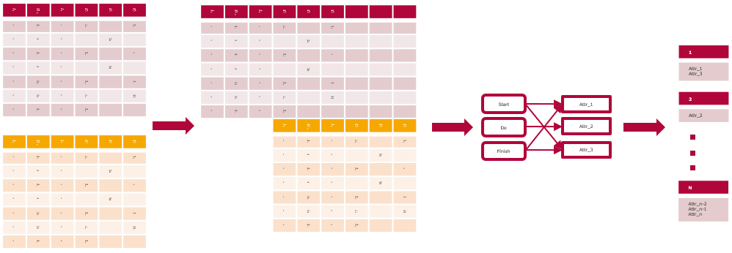
Approach – „Naive“

Slide 8
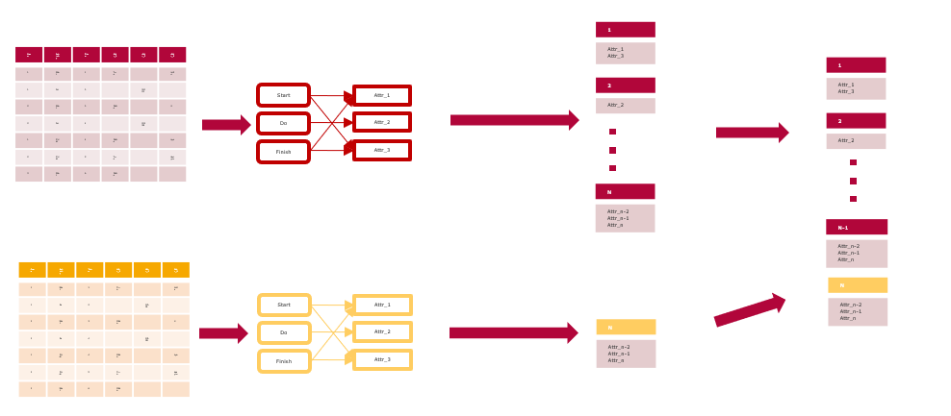
Approach – „Naive“ v2

Slide 9
A2A Diagrams - Example
Access
Att1
A
Att2
B
Activities
Attributes
Att3
C
Att4

Slide 10
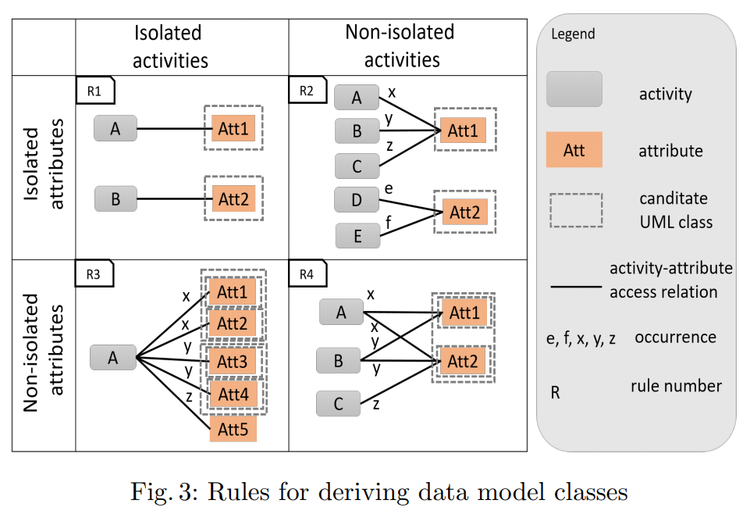
A2A Diagrams

Slide 11
A2A Diagrams - Example
Att1
A
Att2
B
Att3
C
Att4

Slide 12
A2A Diagrams - Example
Att1
A
Att2
B
Att3
Attr4

Slide 13
A2A Diagrams – Data Structure
A
x
Att1
x
y
Att2
B
x
y
Att3
C
x
Att4
 | Att1 | Att2 | Att3 | Att4
A | x | x | 0 | 0
B | y | x | y | 0
C | 0 | 0 | 0 | x

Slide 14
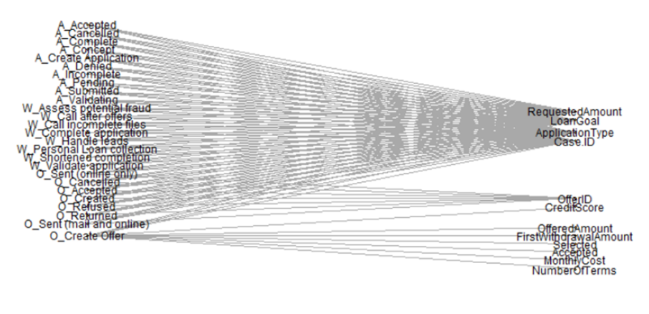
A2A Diagrams – Real World Example
A2A diagram for one BPI challenge 2017 event log

Slide 15
Intermission: Dataset – BPI Challenge 2017
Two event logs
1160405 events, 13 attributes
193849 events, 11 attributes

Slide 16
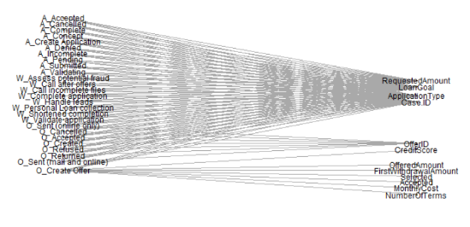
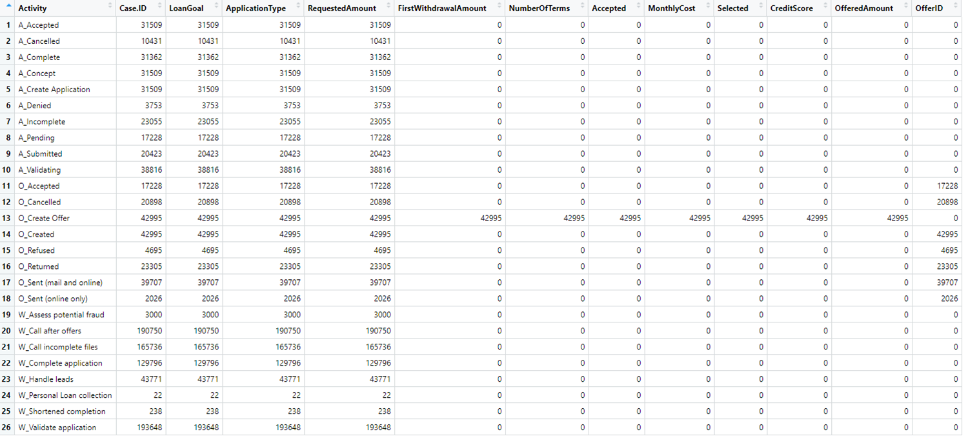
A2A Diagrams – Data Structure

Slide 17
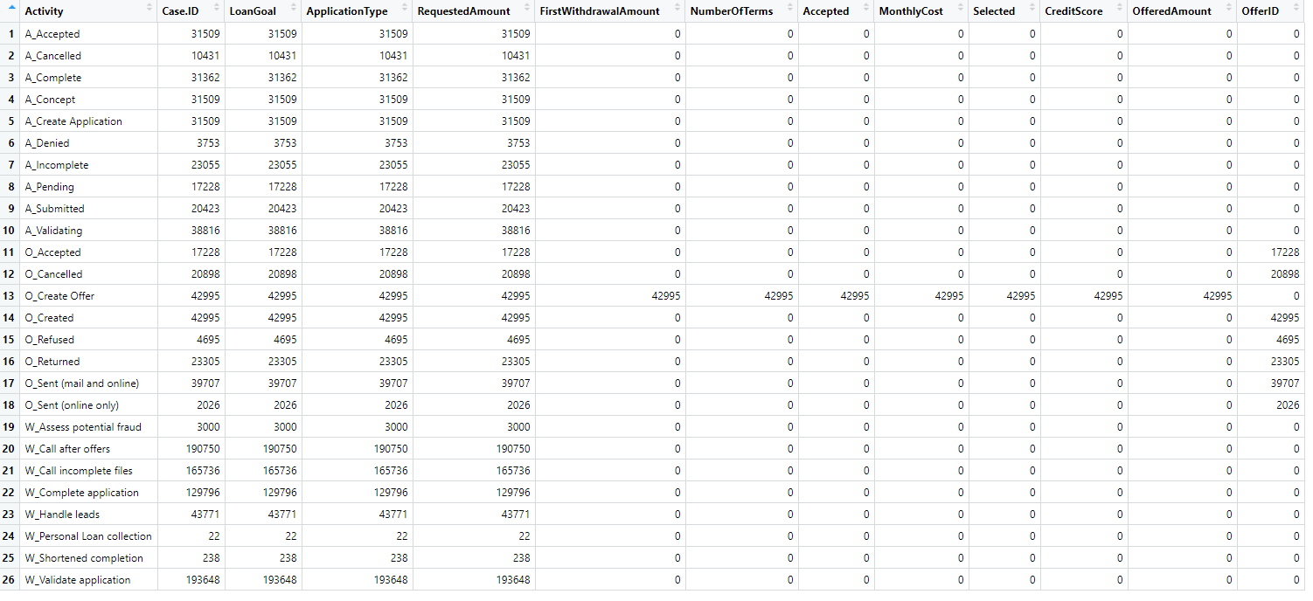
Underlying Model – Which Attributes Belong Together?

Slide 18
Underlying Model – Which Attributes Belong Together?
Activity | Att1 | Att2 | Att3 | Att4 | Att5 | Att6 | Att7
A |  |  |  |  | 0
B | 0 | 0 | 0 | 0 | x | 0 | 0
C |  |  |  |  | 0
D |  |  |  |  | 0
E |  |  |  |  | 0
Rule 1

Slide 19
Underlying Model – Which Attributes Belong Together?
Activity | Att1 | Att2 | Att3 | Att4 | Att5 | Att6 | Att7
A |  |  |  |  | 0
B | 0 | 0 | 0 | 0 | x | 0 | 0
C |  |  |  |  | 0
D |  |  |  |  | 0
E |  |  |  |  | 0
Activity | Att1 | Att2 | Att3 | Att4 | Att5 | Att6 | Att7
A |  |  |  |  | 0
B | 0 | 0 | 0 | 0 | x | 0 | 0
C | 0 | 0 | 0 | 0 | x | 0 | 0
D | 0 | 0 | 0 | 0 | x | 0 | 0
E |  |  |  |  | 0
Rule 2

Slide 20
Underlying Model – Which Attributes Belong Together?
Activity | Att1 | Att2 | Att3 | Att4 | Att5 | Att6 | Att7
A |  |  |  |  | 0
B | 0 | 0 | 0 | 0 | x | 0 | 0
C |  |  |  |  | 0
D |  |  |  |  | 0
E |  |  |  |  | 0
Activity | Att1 | Att2 | Att3 | Att4 | Att5 | Att6 | Att7
A |  |  | 0 | 0 | 0
B | 0 | 0 | x | x | x | 0 | 0
C |  |  | 0 | 0 | 0
D |  |  | 0 | 0 | 0
E |  |  | 0 | 0 | 0
Rule 3

Slide 21
Underlying Model – Which Attributes Belong Together?
Activity | Att1 | Att2 | Att3 | Att4 | Att5 | Att6 | Att7
A |  |  |  |  | 0
B | 0 | 0 | 0 | 0 | x | 0 | 0
C |  |  |  |  | 0
D |  |  |  |  | 0
E |  |  |  |  | 0
Activity | Att1 | Att2 | Att3 | Att4 | Att5 | Att6 | Att7
A | z | 0 | 0 | m | n | z | 0
B | y | y | x | x | x | 0 | z
C | 0 | x | 0 | z | 0 | y | x
D | x | 0 | 0 | 0 | y | z | 0
E | 0 | y | 0 | x | 0 | 0 | x
Rule 4

Slide 22
Underlying Model – Which Attributes Belong Together?
Activity | Att1 | Att2 | Att3 | Att4 | Att5 | Att6 | Att7
A |  |  |  |  | 0
B | 0 | 0 | 0 | 0 | x | 0 | 0
C |  |  |  |  | 0
D |  |  |  |  | 0
E |  |  |  |  | 0
Activity | Att1 | Att2 | Att3 | Att4 | Att5 | Att6 | Att7
A | z | 0 | 0 | m | n | z | 0
B | y | y | x | x | x | 0 | z
C | 0 | x | 0 | z | 0 | y | x
D | x | 0 | 0 | 0 | y | z | 0
E | 0 | y | 0 | x | 0 | 0 | x
Activity | Att1 | Att2 | Att3 | Att4 | Att5 | Att6 | Att7
A | z | 0 | 0 | m | n | z | 0
B | y | y | x | x | x | 0 | z
C | 0 | x | 0 | z | 0 | y | x
D | x | 0 | 0 | 0 | y | z | 0
E | 0 | y | 0 | x | 0 | 0
Rule 4

Slide 23
Underlying Model – Which Attributes Belong Together?
Activity | Att1 | Att2 | Att3 | Att4 | Att5 | Att6 | Att7
A |  |  |  |  | 0
B | 0 | 0 | 0 | 0 | x | 0 | 0
C |  |  |  |  | 0
D |  |  |  |  | 0
E |  |  |  |  | 0
Activity | Att1 | Att2 | Att3 | Att4 | Att5 | Att6 | Att7
A | z | 0 | 0 | m | n | z | 0
B | y | y | x | x | x | 0 | z
C | 0 | x | 0 | z | 0 | y | x
D | x | 0 | 0 | 0 | y | z | 0
E | 0 | y | 0 | x | 0 | 0 | x
Activity | Att1 | Att2 | Att3 | Att4 | Att5 | Att6 | Att7
A | z | 0 | 0 | m | n | z | 0
B | y | y | x | x | x | 0 | z
C | 0 | x | 0 | z | 0 | y | x
D | x | 0 | 0 | 0 | y | z | 0
E | 0 | y | 0 | x | 0 | 0 | x
Rule 4

Slide 24
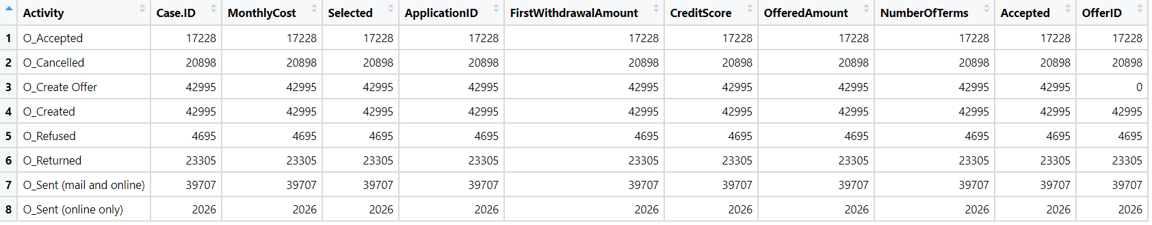

Slide 25
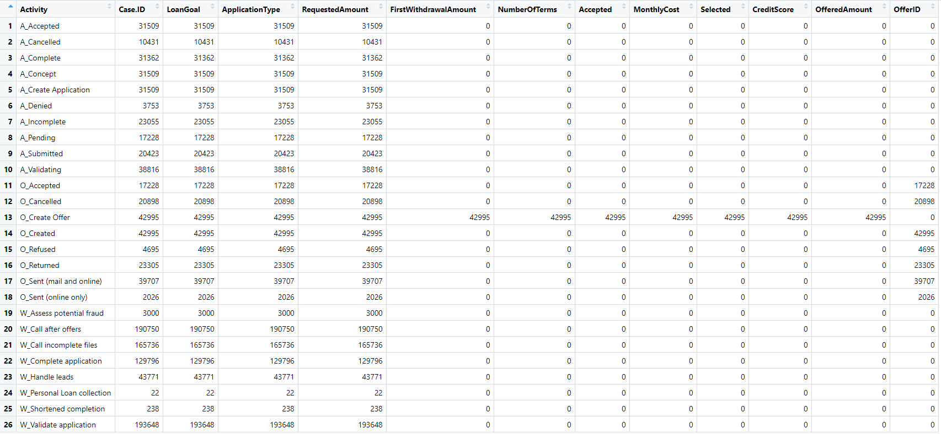

Slide 26
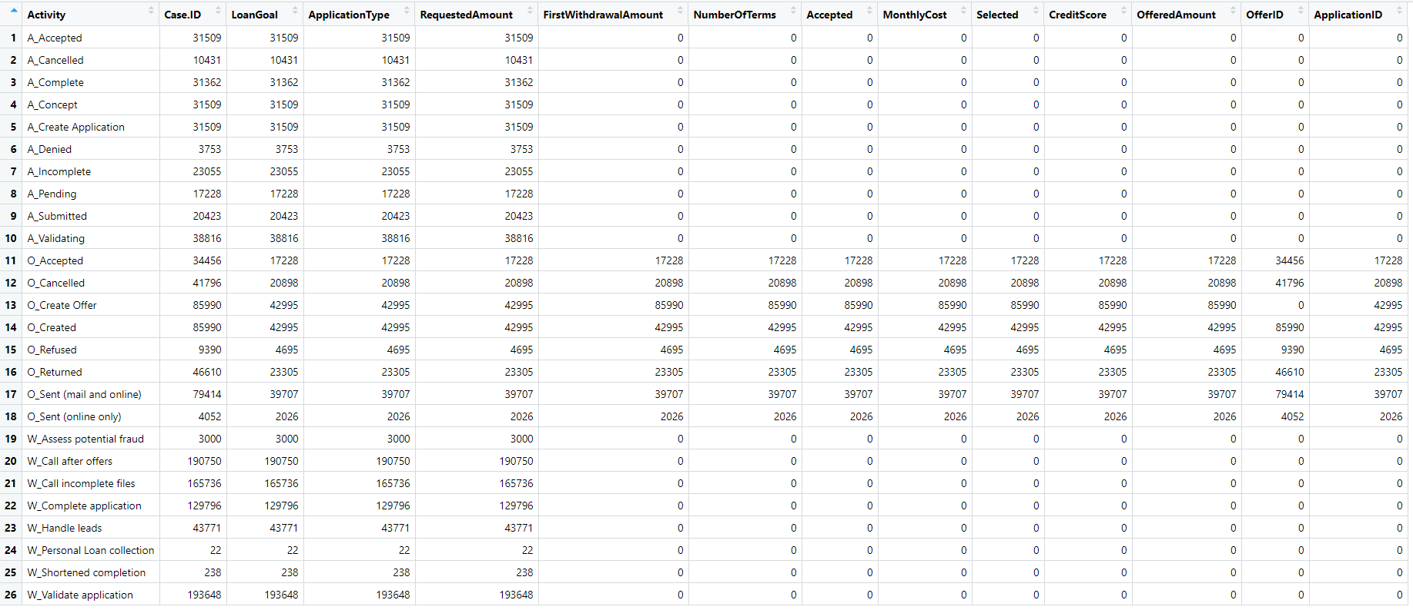

Slide 27
New Rule: Multilog Access
Each set of attributes accessed by multiple event logs is treated as one data model class.

Slide 28
New Rule: Multilog Access
Each set of attributes accessed by multiple event logs is treated as one data model class.
t1
Case.ID
FirstWithdrawalAmount
NumberOfTerms
Accepted
MonthlyCost
Selected
CreditScore
OfferedAmount
OfferID

Slide 29
Definition: Fully connected a2a
Event logs in which all activities access all attributes
Att1
 | Att1 | Att2 | Att3
A | x | y | z
B | x | y | x
C | x | x | y
A
Att2
B
Att3
C
Att4

Slide 30
Definition: Partially Fully Connected a2a Subset
Event logs in which a subset activities always accesses a subset of attributes
Att1
 | Att1 | Att2 | Att3 | Att4
A | x | y | z | 0
B | x | x | x | 0
C | x | x | x | 0
D | 0 | 0 | 0 | y
A
Att2
B
Att3
C
Att4
D
Att5

Slide 31
New Rule: Partially Fully Connected a2a Subset
Attributes belonging to partially fully connected a2a subsets are treated as belonging to one data class
c1
Case.ID
FirstWithdrawalAmount
NumberOfTerms
Accepted
MonthlyCost
Selected
CreditScore
OfferedAmount
OfferID
c2
LoanGoal
ApplicationType
RequestedAmount
ApplicationId

Slide 32
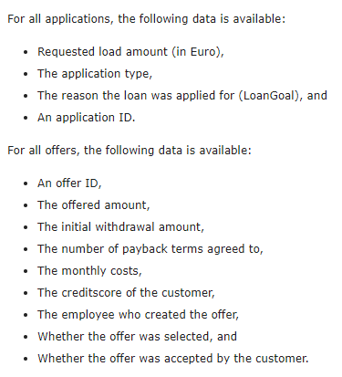
BPI 2017 Challenge Data Definition vs. Result
https://www.win.tue.nl/bpi/doku.php?id=2017:challenge
c2
LoanGoal
ApplicationType
RequestedAmount
ApplicationId
c1
Case.ID
FirstWithdrawalAmount
NumberOfTerms
Accepted
MonthlyCost
Selected
CreditScore
OfferedAmount
OfferID

Slide 33
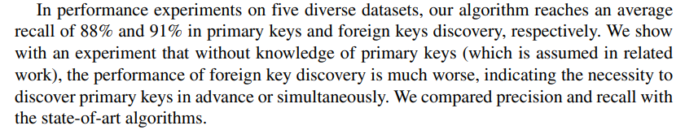
Limitations - Key Matching
c1
Case.ID
FirstWithdrawalAmount
NumberOfTerms
Accepted
MonthlyCost
Selected
CreditScore
OfferedAmount
OfferID
c2
LoanGoal
ApplicationType
RequestedAmount
ApplicationId
Jiang, L., Naumann, F. Holistic primary key and foreign key detection. J Intell Inf Syst 54, 439–461 (2020)

Slide 34
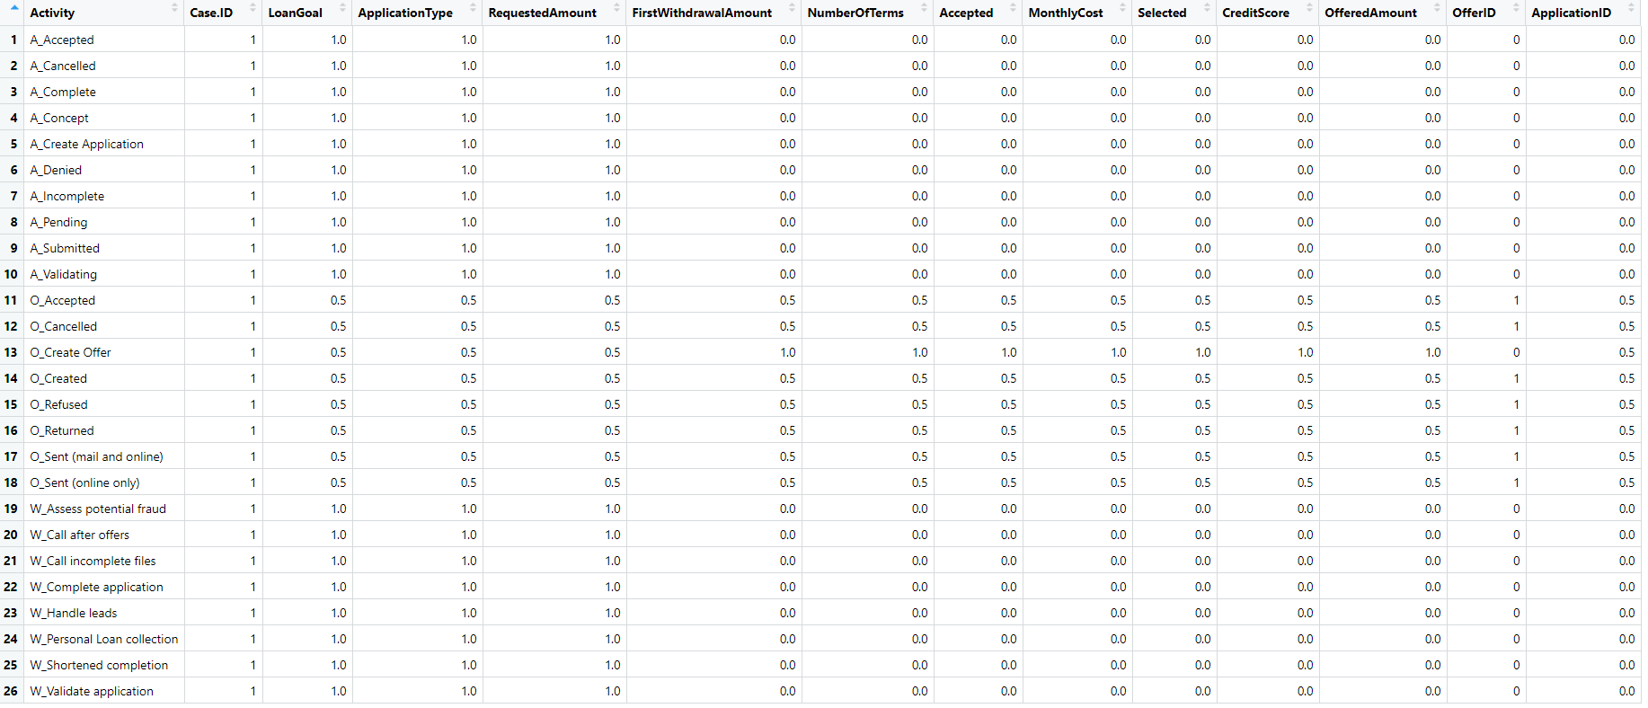
OfferApplicationUnion - Relative Accesses

Slide 35
Dataset Overview – BPI Challenge 2020
Dataset of five event logs
86581 events, 170 attributes
56437 events, 7 attributes
72151 events, 20 attributes
18246 events, 19 attributes
36796 events, 11 attributes

Slide 36
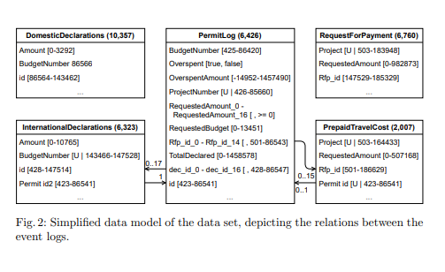
Dataset Overview – BPI Challenge 2020
Dorina Bano , Maximilian Volker , Simon Remy , Henrik Leopold , and Mathias Weske. (2020).
Multi-perspective Analysis of Approval Processes based on Multiple Event Logs

Slide 37
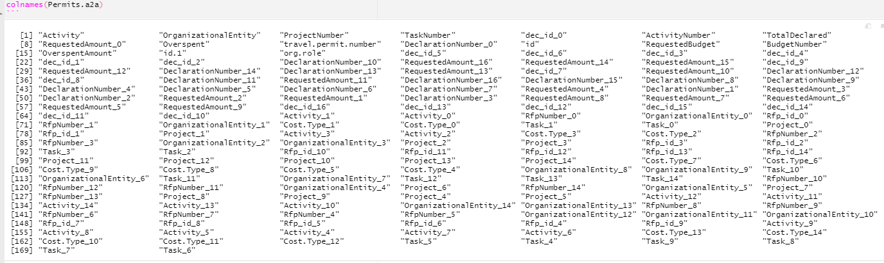
Dataset Overview – BPI Challenge 2020

Slide 38
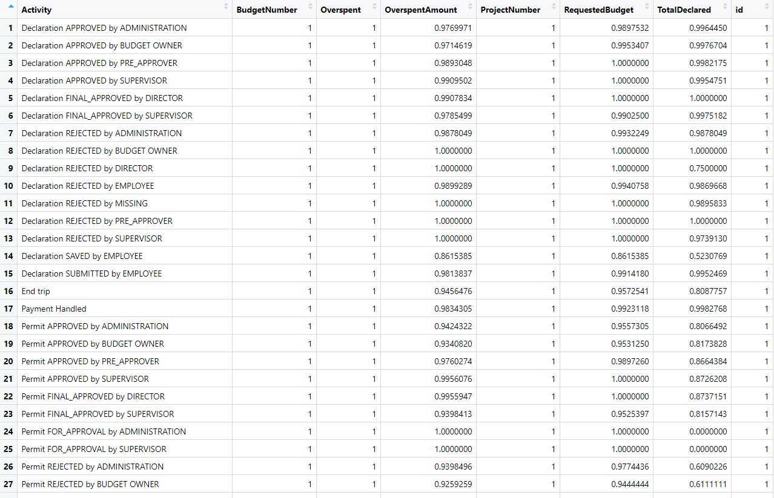
Partial Fully-Connectedness in PermitLogs

Slide 39
Partial Fully-Connectedness in PermitLogs

Slide 40
Limitations - Key Matching
Dorina Bano , Maximilian Volker , Simon Remy , Henrik Leopold , and Mathias Weske. (2020).
Multi-perspective Analysis of Approval Processes based on Multiple Event Logs

Slide 41
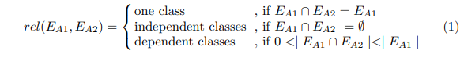

Slide 42
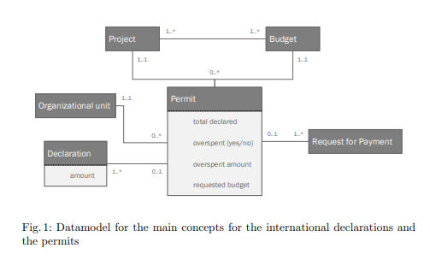
Van Bakel, Hulscher, Klijs, Sturm. (2020). Following the money: An exploratory research into the process for international declarations using process mining

Slide 43
Multiple Event Log Characteristics
One „Main“ Log
Secondary event logs often fully connected

Slide 45
Thank you for your attention!
Speaker
Job Description
Institute

Slide 46
Rules in Data - Rule 1
Activity | Att1 | Att2 | Att3 | Att4 | Att5 | Att6 | Att7
A |  |  |  |  | 0
B | 0 | 0 | 0 | 0 | x | 0 | 0
C |  |  |  |  | 0
D |  |  |  |  | 0
E |  |  |  |  | 0

Slide 47
Rules in Data - Rule 2
Activity | Att1 | Att2 | Att3 | Att4 | Att5 | Att6 | Att7
A |  |  |  |  | 0
B | 0 | 0 | 0 | 0 | x | 0 | 0
C | 0 | 0 | 0 | 0 | x | 0 | 0
D | 0 | 0 | 0 | 0 | x | 0 | 0
E |  |  |  |  | 0

Slide 48
Rules in Data - Rule 3
Activity | Att1 | Att2 | Att3 | Att4 | Att5 | Att6 | Att7
A |  |  | 0 | 0 | 0
B | 0 | 0 | x | x | x | 0 | 0
C |  |  | 0 | 0 | 0
D |  |  | 0 | 0 | 0
E |  |  | 0 | 0 | 0

Slide 49
Rules in Data - Rule 4
Activity | Att1 | Att2 | Att3 | Att4 | Att5 | Att6 | Att7
A | z | 0 | 0 | m | n | z | 0
B | y | y | x | x | x | 0 | z
C | 0 | x | 0 | z | 0 | y | x
D | x | 0 | 0 | 0 | y | z | 0
E | 0 | y | 0 | x | 0 | 0 | x

Slide 50
Rule 4
Activity | Att1 | Att2 | Att3 | Att4 | Att5 | Att6 | Att7
A | z | 0 | 0 | m | n | z | 0
B | y | y | x | x | x | 0 | z
C | 0 | x | 0 | z | 0 | y | x
D | x | 0 | 0 | 0 | y | z | 0
E | 0 | y | 0 | x | 0 | 0 | x

Slide 51
Rule 4
Activity | Att1 | Att2 | Att3 | Att4 | Att5 | Att6 | Att7
A | z | 0 | 0 | m | n | z | 0
B | y | y | x | x | x | 0 | z
C | 0 | x | 0 | z | 0 | y | x
D | x | 0 | 0 | 0 | y | z | 0
E | 0 | y | 0 | x | 0 | 0 | x

Slide 53
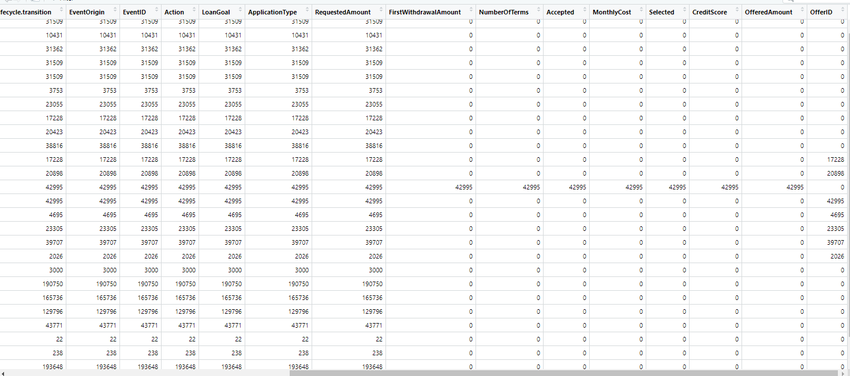

Slide 54
t1
FirstWithdrawalAmount
NumberOfTerms
Accepted
MonthlyCost
Selected
CreditScore
OfferedAmount

Slide 55
t1
FirstWithdrawalAmount
NumberOfTerms
Accepted
MonthlyCost
Selected
CreditScore
OfferedAmount

Slide 56
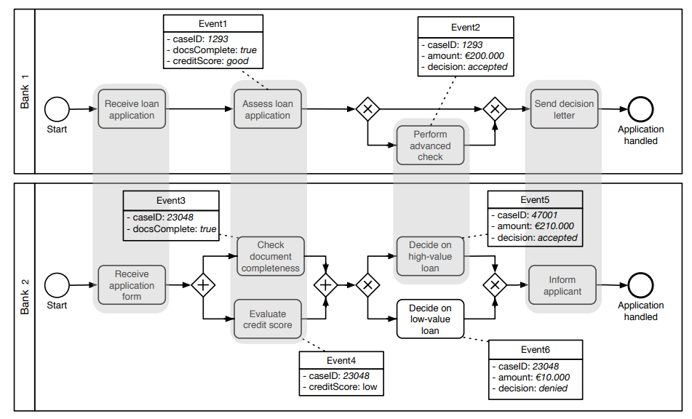
Related Work – Schema Matching on Event Logs
van der Aa, Han & Gal, Avigdor & Leopold, Henrik & Reijers, Hajo & Sagi, Tomer & Shraga, Roee. (2017). Instance-Based Process Matching Using Event-Log Information.
Instance-based approach
Attribute Name Similarity
Attribute Value Similarity
Occurrence Similarity (frequency)
Additional process-related metrics:
Positional Similarity
Duration Similarity
Prerequisites Similarity

Slide 57
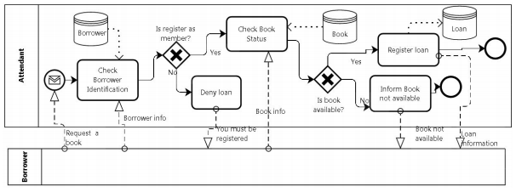
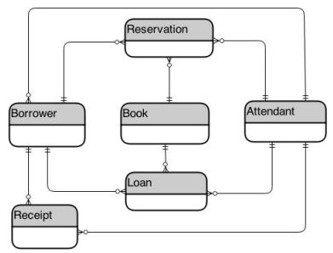
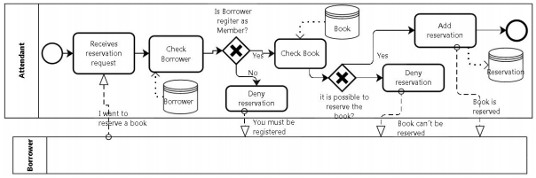
Related Work – Deriving Data Model from Related BPMs
Cruz, Estrela & Machado, Ricardo-J & Santos, Maribel. (2015). Deriving a Data Model from a Set of Interrelated Business Process Models.

Slide 58


Slide 59


Slide 60


Slide 61

Explanations - Text layers
First text layer for running text.
Second level for bullet points
Third level for bullet points
Fourth level for bullet points
Fifth level for numberings
Sixth level for listings
Seventh text layer for Core Messages
In this template, we pre-formatted different text layers (as you can see on the right side). You don’t have to generate bullet points manually. By the way: Please avoid this!
To change from one text layer to the next, use the Increase / Decrease List Level buttons:

Slide 62
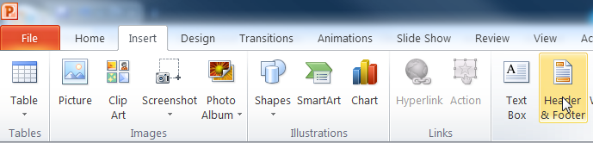
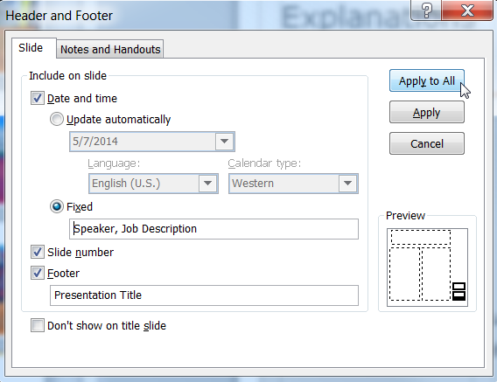
Explanations - Footer
You can insert or change your presentation‘s footer. Click on the Insert-tab | Header and Footer | After filling in your descriptions click on Apply to All.
Descriptions:
Activate date and time and write in:Speaker, Job Description
Activate the slide number.
Activate the footer and write in: Presentation Title
Don‘t use the template without the complete footer.

Slide 63
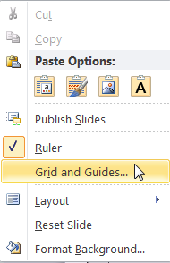
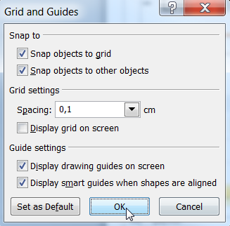
Explanations - Drawing guides
You can enable your guide-lines to align objects on the slide (View | Show | Select the option „Guides“)
Or hit the right mouse button outside the slide and go at „Grid and Guides…“

Slide 64
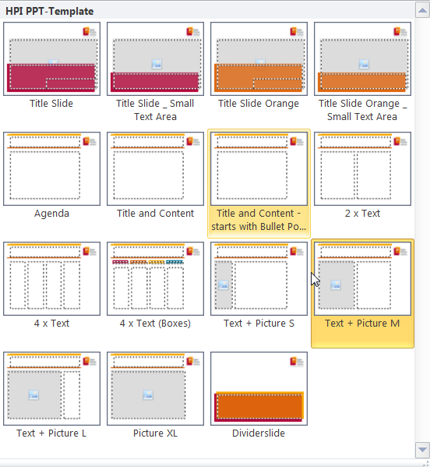
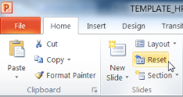
Explanations - Slide layouts
You can choose between different slide layouts. These pre-defined layouts gives you the oportunity to use text and visualisations just the right way.
To use these layouts:
Click on the Home-tab | New Slide or Layout | and choose one out of the layouts
Click „Reset“ to reset to the predefined slide layout.

